Slide 1





How much does this
mobile cost ?
Python(Jupyter Notebook)
March | 2023

Slide 2






Team: Group 12

Slide 3
The Mobile Price Classification dataset on Kaggle is a collection of data on various mobile phone models and their corresponding prices. The dataset contains a total of 2,000 mobile phone models, each represented by 20 features such as battery power, clock speed, internal memory, rear and front camera megapixels, and more.
The goal of this dataset is to predict the price range of a mobile phone, which is categorized into four groups: low cost, medium cost, high cost, and very high cost. The target variable is the price range, which is represented by integers 0, 1, 2, and 3 for the respective price range categories.
March | 2023

Slide 4
Problem statement
Bob founded his own smartphone business. He wishes to fight hard against large corporations like Samsung, Apple, and others.
He is unable to predict the cost of the mobile devices that his business makes. It is imposible to make assumptions in this cut throat mobile phone industry. He gathers sales information on mobile phones from different companies to addres this issue.
Bob is interested in learning the relationship between a mobile phone's characteristics (such as RAM, internal memory, etc.) and the price at which it is sold. However, he struggles with machine learning and has therefore hired a firm to model the price range of mobile phones.
Instead of predicting the exact price in this problem, the firm must provide a price range showing how high the price is.

Slide 5


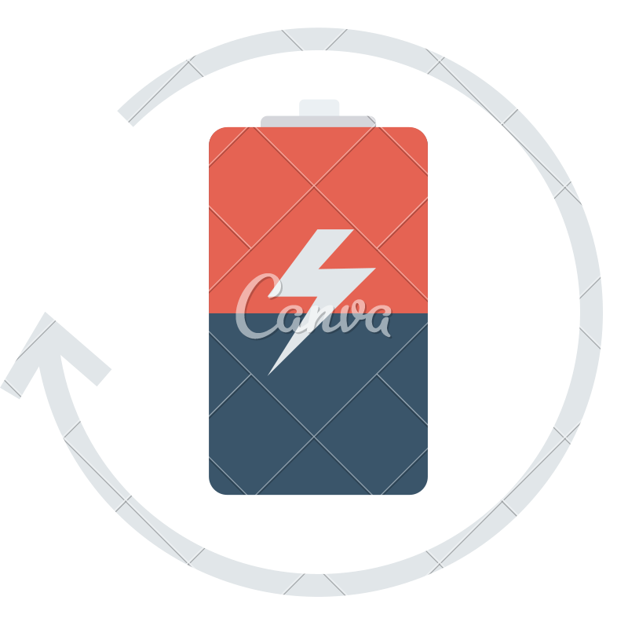






What are we doing?
Estimation of mobile price range based on:
01.
Battery Life
wifi Bluetooth RAM
And many more features...
02.
03.
04.
05.

Slide 6









What do we plan to
achieve ?
enhancement of the pricing strategy
Obtaining a competitive edge
Inventory control
Predicting mobile prices can also be helpful for people who want to sell or purchase mobile
devices because it can give them important information about the fair market value of the device.

Slide 7


Primary
Goal of the Project
Helping Bob (the business) optimize its pricing strategy, improve inventory
management, enhance customer experience, and increase revenue and market share.
Using regression analysis to create an accurate and trustworthy model for forecasting mobile price ranges based on various characteristics, including brand, model, specifications, and market trends.

Slide 8
02. Input variables :
01. Gathering of the data: www.kaggle.com
battery_power blue clock_speed dual_sim
fc four_g
int_memory m_dep mobile_wt n_cores
pc px_height px_width ram
sc_h sc_w talk_time
three_g touch_screen wifi
Description of the dataset

Slide 9

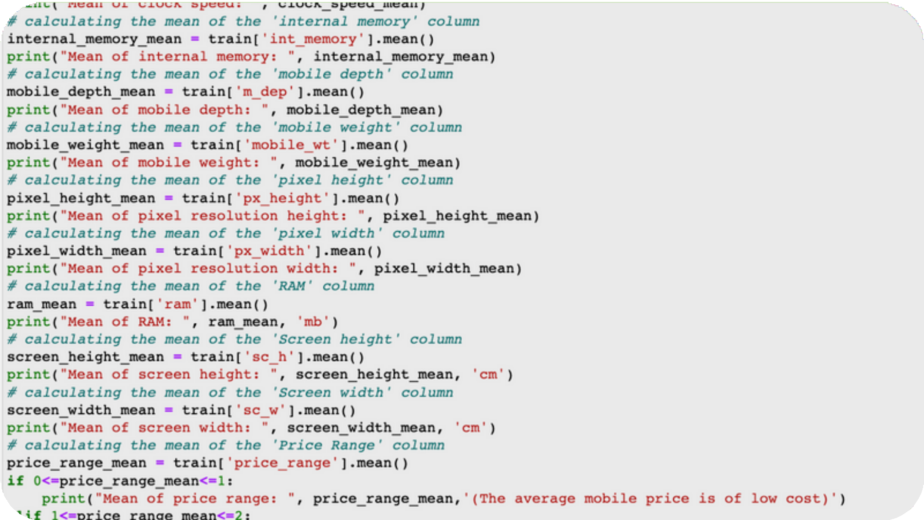
Mean
Mean of battery power: 1238.5185
Mean of clock speed: 1.5222499999999983 Mean of internal memory: 32.0465
Mean of mobile depth: 0.5017500000000017 Mean of mobile weight: 140.249
Mean of pixel resolution height: 645.108 Mean of pixel resolution width: 1251.5155 Mean of RAM: 2124.213 mb
Mean of screen height: 12.3065 cm Mean of screen width: 5.767 cm Mean of price range: 1.5
( The average mobile price is of medium cost)

Slide 10
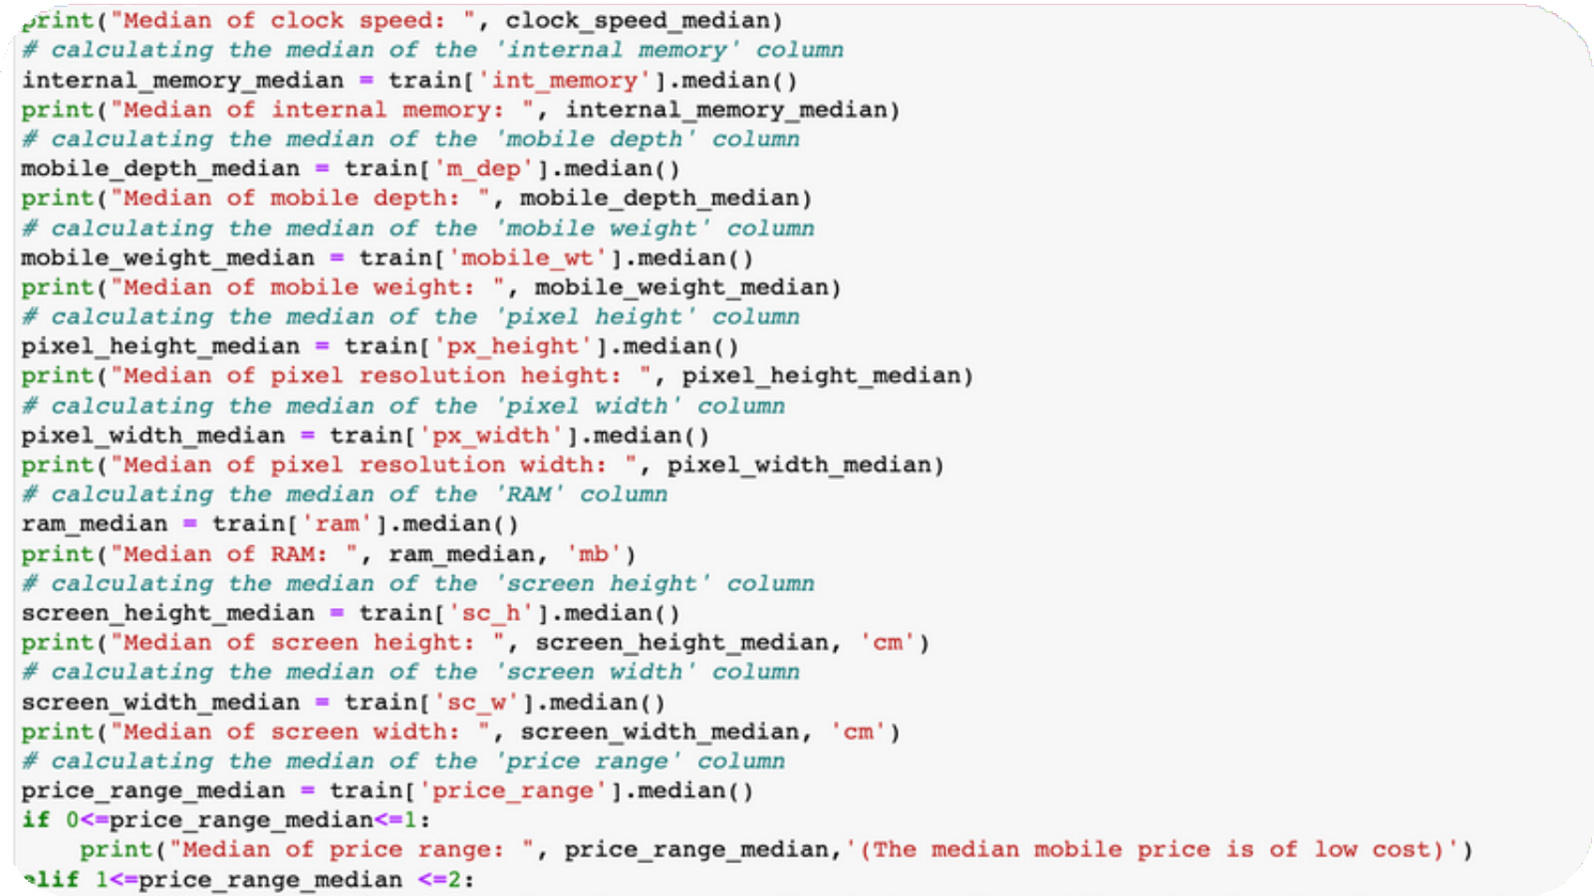
Median
Median of battery power: 1226.0 Median of clock speed: 1.5 Median of internal memory: 32.0 Median of mobile depth: 0.5 Median of mobile weight: 141.0
Median of pixel resolution height: 564.0 Median of pixel resolution width: 1247.0 Median of RAM: 2146.5 mb
Median of screen height: 12.0 cm Median of screen width: 5.0 cm Median of price range: 1.5
(The median mobile price is of medium cost)

Slide 11
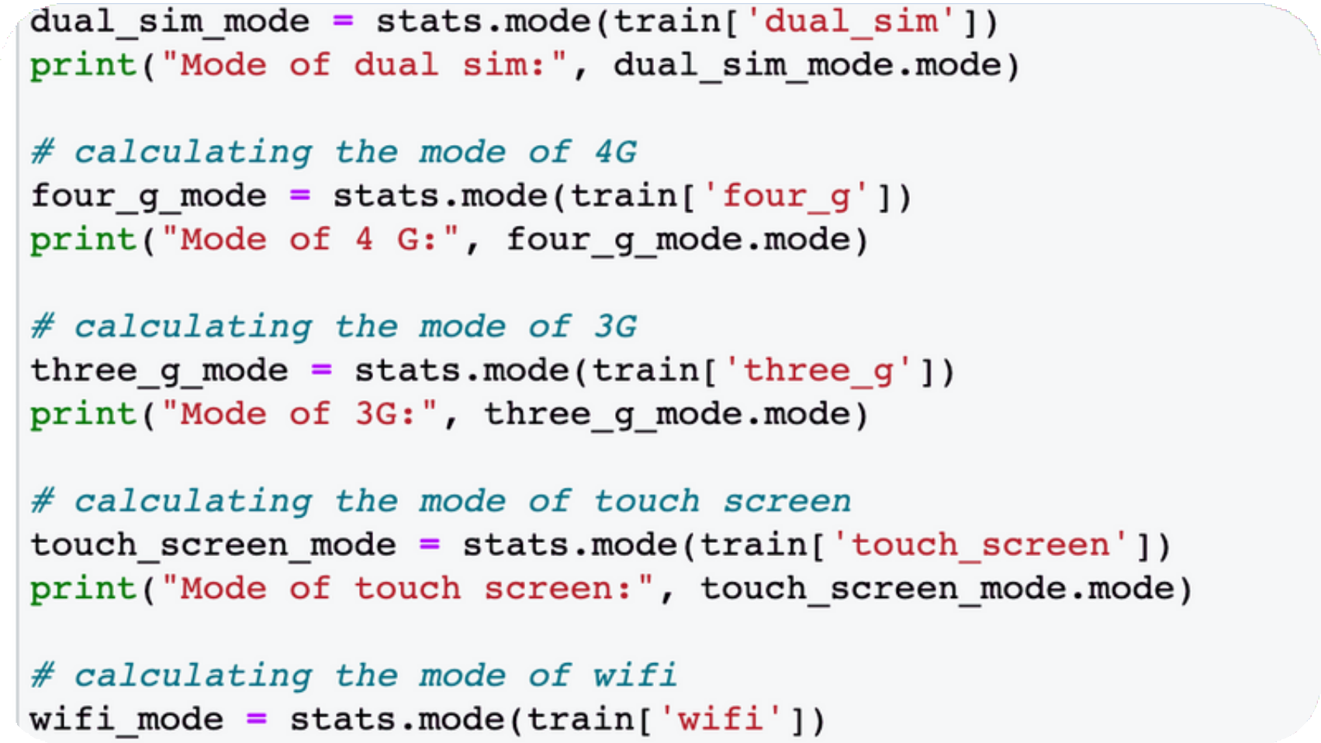
Mode
Mode of bluetooth: [0] Mode of dual sim: [1] Mode of 4 G: [1] Mode of 3G: [1]
Mode of touch screen: [1] Mode of wifi: [1]
Mode of price range: [0]

Slide 12
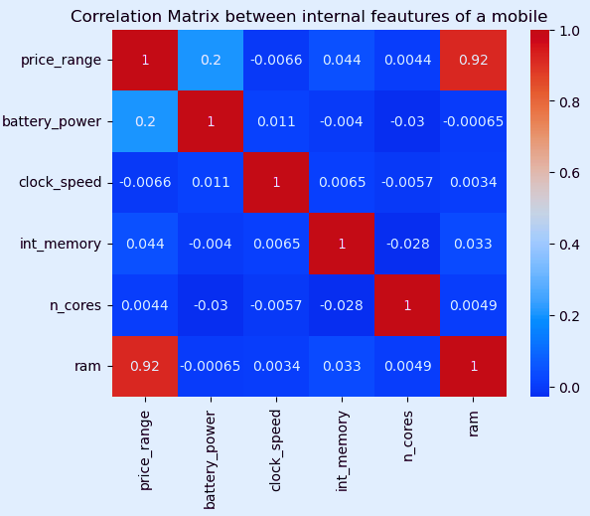

Correlation
matrix: internal features
The given heatmap shows the correlation between a mobile's price range and it's internal feautures.
We can clearly see that a mobile price range has a strong correlation with RAM.

Slide 13

A line chart between Price Range of a mobile and it's battery power states that higher the battery power, higher would be it's cost.
Line Chart : Battery vs Price

Slide 14

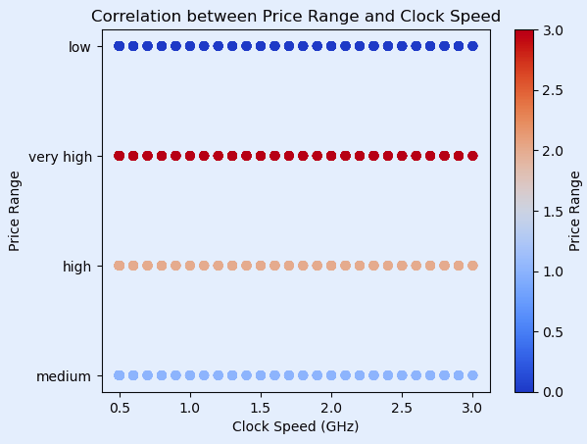

We see a positive correlation between clock speed and price range. In other words, as clock speed increases, we would expect to see an increase in price range.
Correlation: price range & clock speed

Slide 15
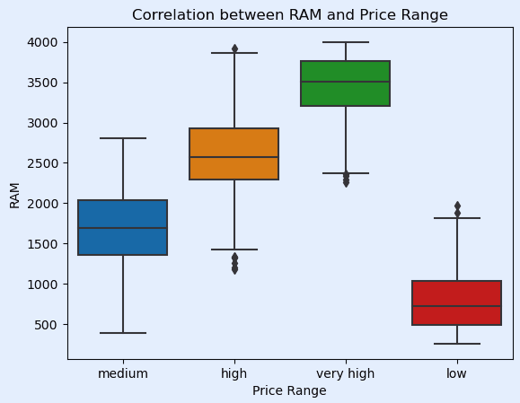

Since there is a positive correlation between a mobile's price range and RAM, we see higher median and quartile values for RAM as we move from lower to higher price range categories.
Correlation:
RAM& price range

Slide 16

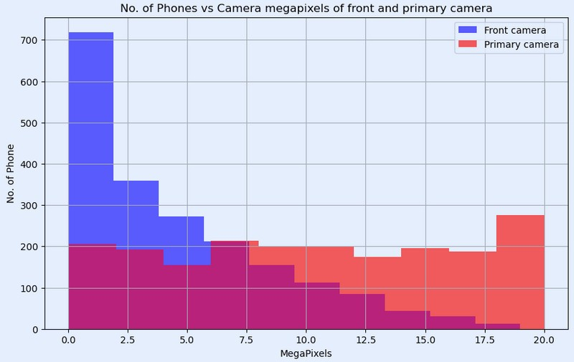
The histogram shows that highest no. of mobile phones are the ones where front camera megapixels ranges from 0 to 5, and as the mp increases, the no. of phones decrease because more camera feautures leads to higher price range of a mobile.

Slide 17
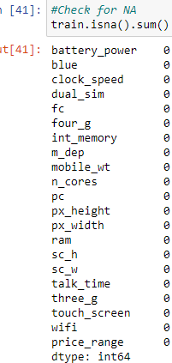
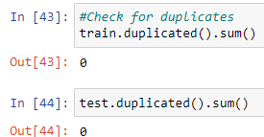
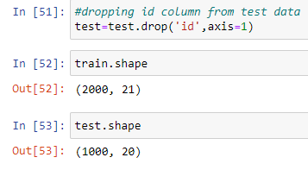
Data Preprocessing
Checked for duplicates Checked for values that are NA
Dropped unnecessary columns
Scaling the numerical columns
Renaming the columns, and many more .

Slide 18
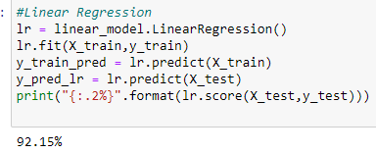
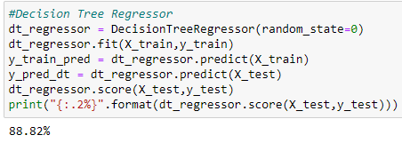
Fitting the
models
Decision Tree
Linear

Slide 19
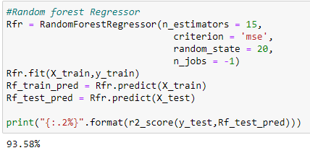
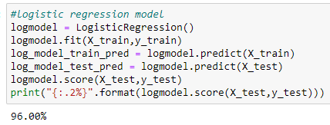
Fitting the
models
Logistic
Random forest

Slide 20

Results of Modeling
We applied four models:
Linear Regression Decision - 92.15%
Decision Tree Regressor - 88.12%
Random Forest Regressor - 93.58%
Logistic Regressor - 96%
An accuracy of 96% means that the logistic regression model correctly predicted the price range category for 96% of the mobile phones in the test dataset. This is a high accuracy and suggests that the model is performing well at predicting the price range of mobile phones based on their specifications.

Slide 21




creating marketing and product development strategies for maximizing revenue
understanding consumer behaviour & analyzing pricing strategies
help the business avoid overstocking or under stocking and improving cash flow.
help the business identify new opportunities for growth, such as entering new markets or launching new devices, which can increase market share and brand reputation.
Implications of
price prediction

